Slide 1
Coursera Capstone
IBM Applied Data Science Capstone
Finding ideal House in New Delhi
By: Siddhant Bhanot

Slide 2
Introduction
When looking to buy a house, location of the house and the cost are two of the major factors to be considered.
Location plays an important role as one wants a house a location having the maximum amenities along with a suitable price value.
In this project I have classified various localities of the city of New Delhi, India based on the amenities offered and the average cost of the houses.

Slide 3
Business Problem:
The objective of this capstone project is to analyze and select the best location suitable for a person to buy a house, based on the amenities offered in that location and price of the house.

Slide 4
Data
The following data is required
List of neighborhoods along with average price per square feet of the house for the neighborhood for the city of New Delhi.
Latitude and Longitude of the given localities.
Amenities around the given location.

Slide 5
Methodology
Web scraping makaan.com page for neighbourhoods list along with prices of house.
Get latitude and longitude coordinates using Geocoder
Use Foursquare API to get venue data
Group data by neighbourhood and taking the mean of the frequency of occurrence of each venue category
Perform clustering on the data by using k-means clustering
Visualize the clusters in a map using Folium

Slide 6
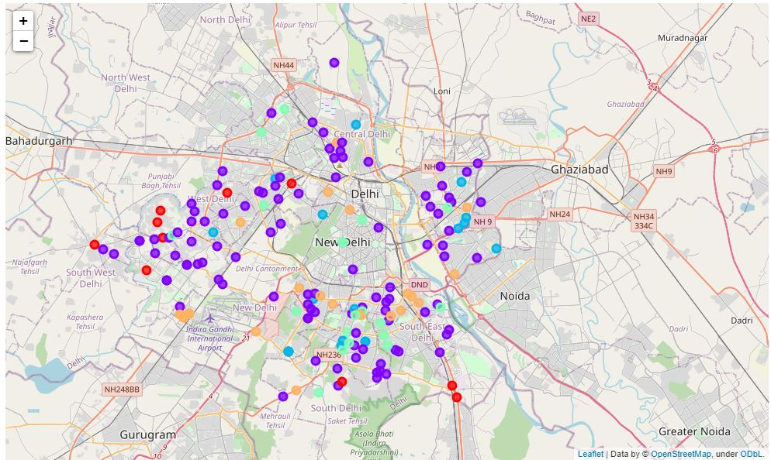
Results
Categorizing the neighborhoods into 5 clusters based on the frequency of occurrence of different venues and the average price of houses in that neighborhood.
Cluster 1 is the most cheap
Cluster 2,3 and 4 are have moderate prices of houses.
Cluster 5 has the highest prices of houses.

Slide 7

Thank you!

